Slide 1
Electrical - B

Slide 2
Group Persons
Lakhani Chirag
Makwana Hitesh
Megal Ketan
Mehta Ronak
Modhvadya Savdas
Odedra Jayesh
Parmar Shailesh
Purohit Karan

Slide 3
AC Fundamentals

Slide 4
Definition Of AC Quntity
An Alternating (AC) quantity is defined as the one which changes its value as well as direction with respect to time.
All our appliances such as TV,refrigerators, washing machines, air conditioners, fans etc.

Slide 5
Comparison of AC & DC
Sr. No | Parameter | AC | DC
1 | Definition | It is a single which change its magnitude as well as polarity | It is a single which change its magnitude but dose not change in polarity
2 | Use of transformer | Possible | Not-Possible
3 | Generation | Easy | From the ac waveform using commutator or rectifier
4 | Distribution | High | Low

Slide 6
Advantages of AC over DC
It is possible to use transformer.
Distribution efficiency is high.
Generation is easy.
Design of ac machines is easy.
Installation is less costly.

Slide 7
Definitions
Waveform : Waveform is a graph of magnitude of AC quantity arainst time. The waveform tells us about intantaneous change in the magnitude of AC waveform.
Instantaneous value : Instantaneous value of an ac quantity is defined as the value of the quantity at a particular instant of the time.
Cycle : In a ac waveform particular portion consisting of one positive and negative part repeats many time.
Time period (T) : Time period (T) is defined as the time taken in second by the waveform of an ac quantity to complete one cycle
Frequency (f) : Frequency is defined as the number of the cycle complete by an Alternating quantity in the second. It is denoted by “f” and its units are cycle/second or Hertz(Hz).

Slide 8
Amplitude : The maximum value or peak value of an ac quantity is called as its amplitude.
Angular Velocity : The angular velocity is the rate of change of the angle wt with respect to time.
Average Value : The average value of an alternating quantity is equal to the average of all, the instantaneous value over a period of half cycle.

Slide 9
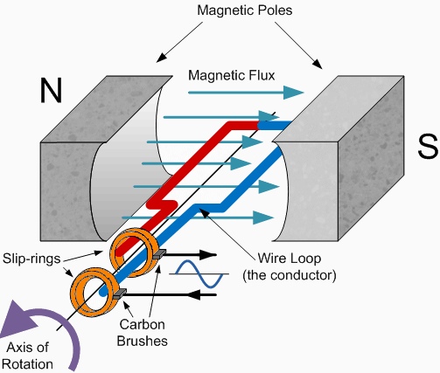
Generation of single phase AC waveform

Slide 10
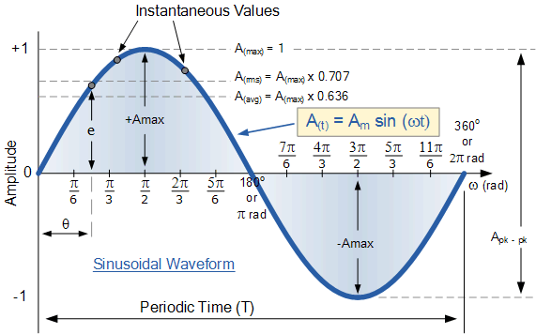
AC Waveform

Slide 11
The End

